Slide 1
CSI 3450 Project
By: Martin Hughes, Y Duong & Jake Gleason

Slide 2
Application Scenario and Problem Statement
Application Scenario: We built this application to streamline the process of purchasing, viewing, and researching the various GPUs available on the market. We want to provide an all encompassing experience for potential customers who wish to reduce the hassle of getting their hands on one.
Problem Statement: Our project aims to create a database of graphics cards that provides functionality to both people that want to purchase them and those who are selling (us, in this case). Potential customers can view information about specific graphics cards, including RAM, boost clock, price, etc. It provides all the information in one place and can filter for specific aspects. Once they’ve decided which GPU they want, they also have the ability to purchase from us. As the sellers, we can manage the stock, edit the types of cards available, and put in restock requests directly to the manufacturers.

Slide 3
Functional Requirements
Users must login to be able to purchase a graphics card.
Users can sort the table by different options (Ex: price, brand, model, etc.)
Users can view information on graphics cards.
Users can search for any available graphics card that are currently being sold.
System will grant administrative privileges for manager users
Managers have privileges that allow them to edit entries.
Managers have privileges that allow them to add entries.
Managers have privileges that allow them to delete entries.
Managers have privileges that allow them to contact manufacturers to request more graphics cards

Slide 4
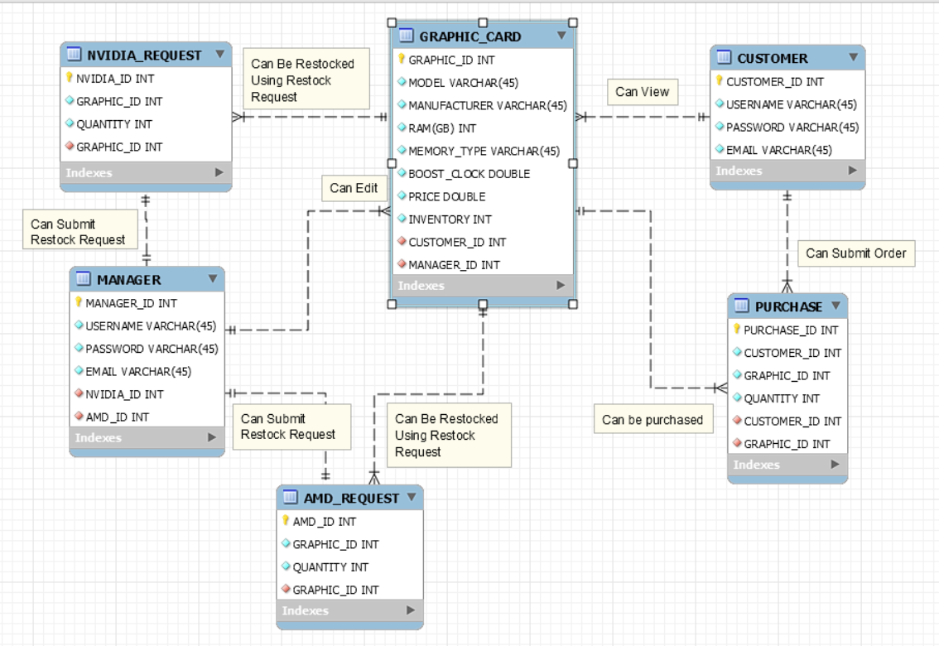
ER-Diagrams

Slide 5




Tools Used To Implement The Project
MySQL Server
IntelliJ
GitHub
Java

